Slide 1
Project
Development Process
Nature has Great Organizing Power

Slide 2
Iterative Development
Iterative and Incremental development is any combination of both an iterative design or an iterative method and an incremental build model for software development. The combination is of long standing and has been widely suggested for large development efforts.
Iterative and incremental development are essential parts of the Modified waterfall models, Rational Unified Process, Extreme Programming and generally the various agile software development frameworks.

Slide 3
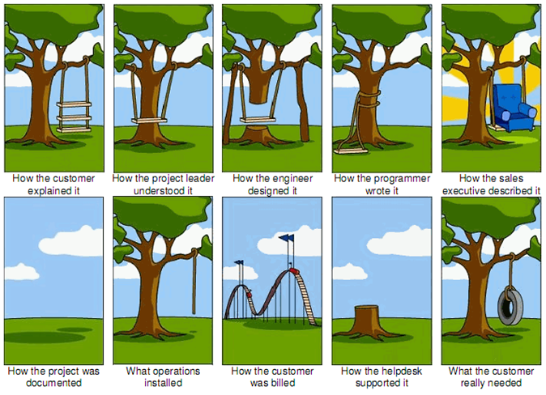

Slide 4
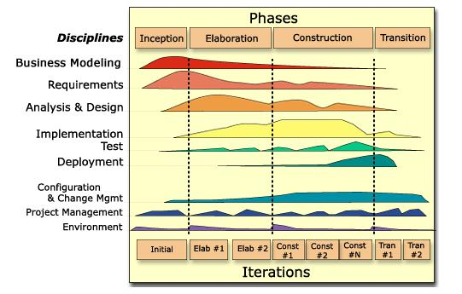
Rational Unified Process
Incorporates all elements of business process
Iterative process identifies risk early in the lifecycle
React to each risk in an efficient manner
Keeps project on schedule
Drives project in a predictable and repeatable manner
Architecture-centric approach.

Slide 5
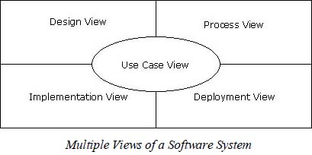
UML - RUP
Tre Amigos
“Fathers of UML”
Booch, Rumbaugh, Jacobsen
Mid-1990’s – at Rational
Class & Bevavioral Diagrams
Activity Diagrams
Component & Package Diagrams
Deployment Diagrams
Notes:
https://en.wikipedia.org/wiki/OpenUP

Slide 6
Extreme Programming
Programming in pairs
Extensive code review, unit testing of all code,
Flat management structure,
Simplicity and clarity in code,
Frequent communication with the customer and among programmers.
Beneficial elements of traditional software engineering practices are taken to "extreme" levels.
EXAMPLE: Code reviews taken to the extreme, is reviewed continuously, i.e. the practice of Pair programming

Slide 7
SCRUM Process
Development team works as a unit to reach a common goal
Team self-organizes by encouraging physical co-location
Daily face-to-face communication among all team members and disciplines in the project.
MAIN DRIVER:
Problems cannot be fully understood or defined
Focus instead on maximizing the team's ability to deliver quickly and respond to emerging requirements.

Slide 8
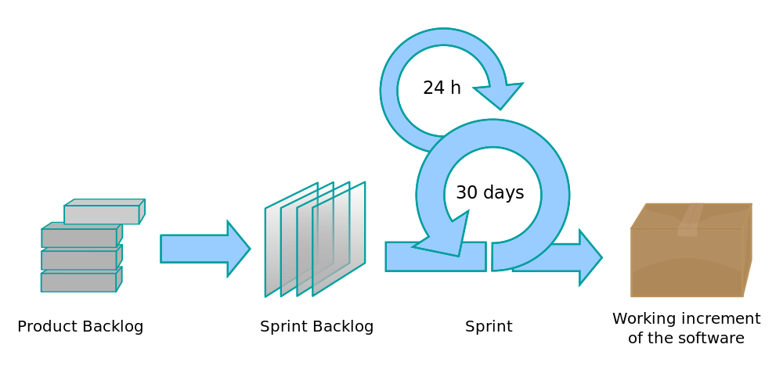
SCRUM Process

Slide 9
Continuous Integration
Merge of all developer working copies with a shared mainline several times a day.
Part of extreme programming(XP), which did advocate multiple integrations a day, perhaps as many as tens a day. The main aim of CI is to prevent integration problems
Intended to be used in combination with automated unit tests written through the practices of test-driven development
Build servers automatically run unit tests periodically or even after every commit and report the results to the developers

Slide 10
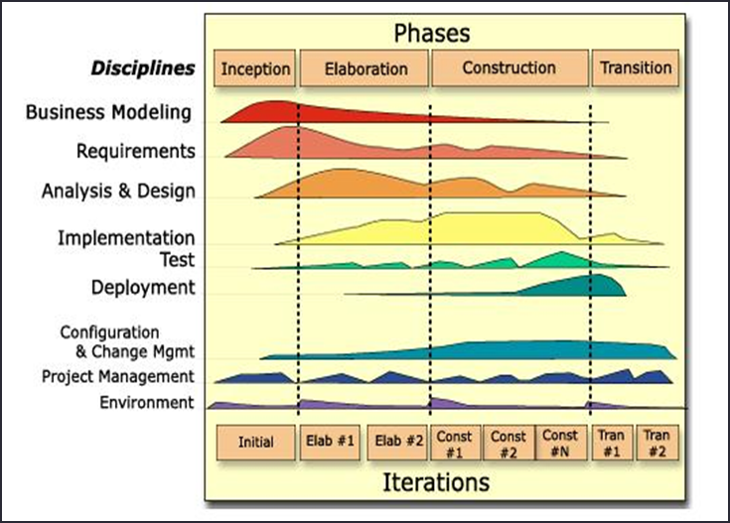
RUP Based Approach

Slide 11
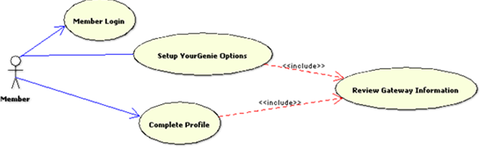
Use Cases

Slide 12
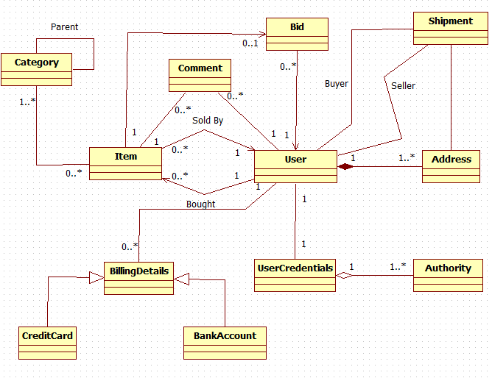
Domain Model

Slide 13
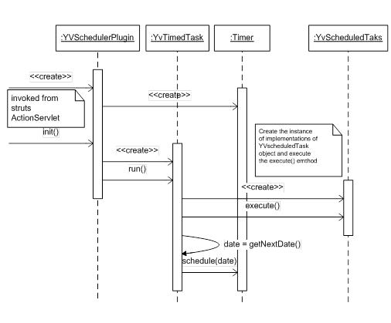
Sequence Diagram
Notes:
Sequence diagrams describe interactions among classes in terms of an exchange of messages over time.

Slide 14
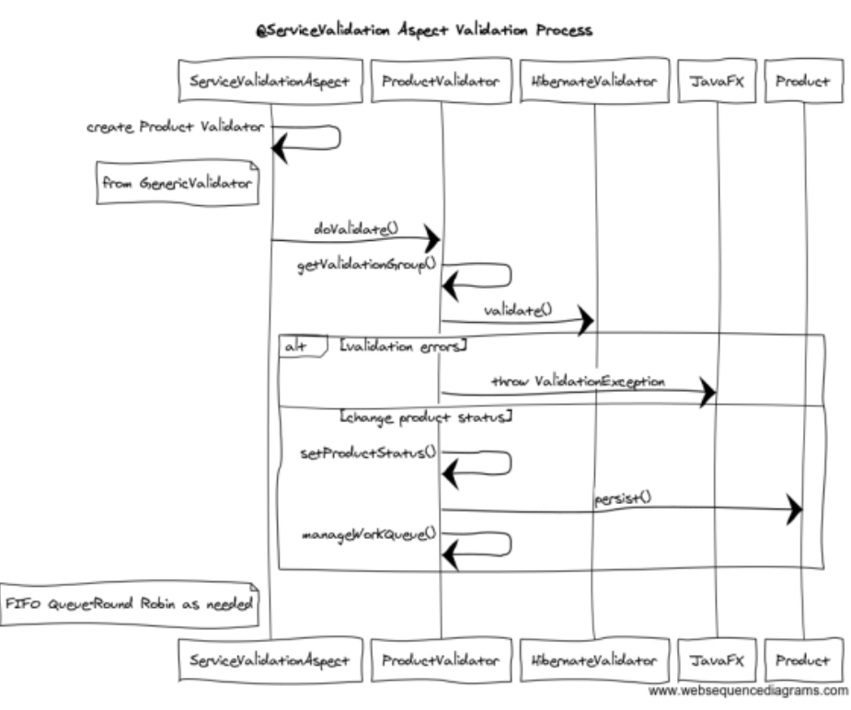
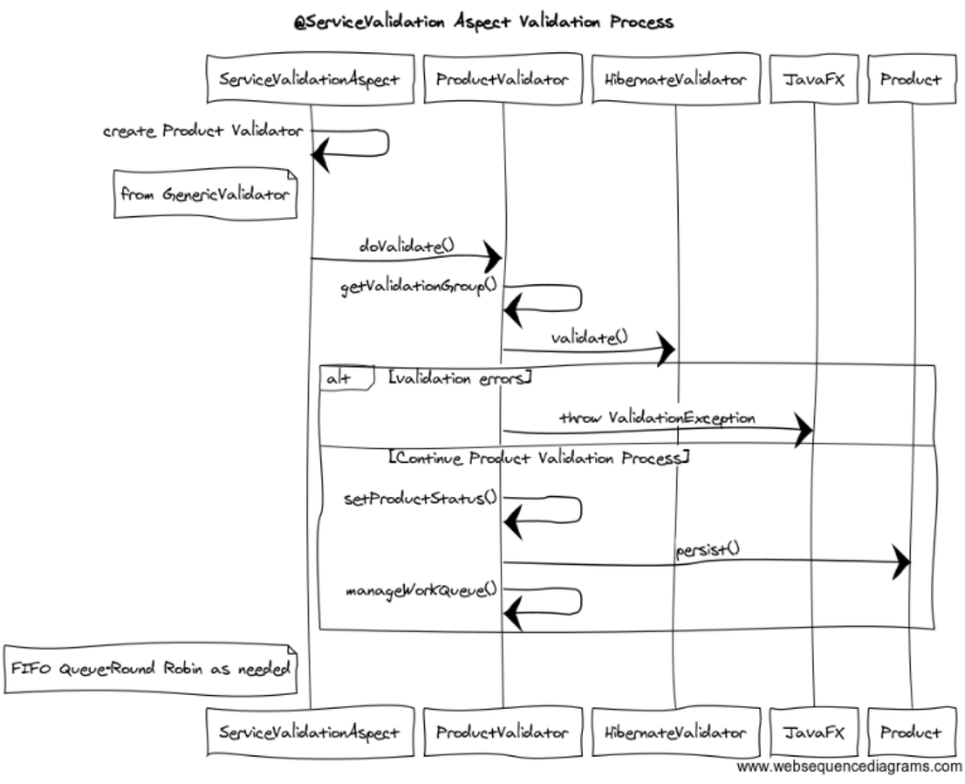
Sequence Diagram
This is @Around Advice
Notes:
https://www.websequencediagrams.com/
@Around Advice does “Before” then Proceed then “After”

Slide 15
Main Point
A good design reflects re-usability and adaptability and most importantly traceability of requirements. A good design promotes stability and flexibility in a business application. The Field of Pure Creative Intelligence is characterized by the qualities of stability and flexibility

Slide 17
Main Point
A good development process has core ingredients use-case driven, iterative, emphasis on testing. Development processes represent the structuring laws that guide successful development of large software systems.
Life unfolds according to the structuring Laws of Nature which are enlivened by Transcendental Consciousness.

